Slide 1

Presentation Title
Capability Overview
Passion To Deliver With Excellence

Slide 2

Background
MENA based technical and engineering services company with over 50 years of history in Saudi Arabia and other regions.
Head Quartered in Saudi Arabia, the group operates under the name AHCEC MENA, which was spun off Abdulhadi & Al Moaibed Consulting & Design Engineers (AMCDE) while establishing a separate engineering joint venture with KBR in Saudi Arabia, currently known as KBR-AMCDE.
Today MENAISCO operates across the Middle East and North Africa regions with Governments, Multinational Corporations, Utilities and National Oil Companies to help them design, construct and operate projects, in sectors including Power and Water, Oil and Gas and Petrochemicals.
The combined entities have footprint across the entire MENA region and a workforce of more than 800 skilled professionals.

Slide 3


Quality Policy
“DO IT ONCE, DO IT RIGHT”
It is the policy of MENAISCO, to establish, maintain and continuously develop its “Quality
System” with the setting out of quality objectives in line with the framework laid down
within ISO 9001:2008 Standard.
ISO 9001:2008 Certified

Slide 4

Health & Safety Policy
In compliance with OHSAS 18001:2007, MENAISCO is committed to ensuring a safe and healthy working environment for all its employees.
MENAISCO believes that most work-related injuries and diseases are preventable and that a "zero accident" target is desirable.
MENAISCO considers that there is nothing more important in the undertaking of anyone's job than prevention of injury or ill-health to people in its workplace.
MENAISCO recognizes that its managers and supervisors have primary responsibility for providing and maintaining a working environment that is safe and without risks to health.
Safety Always First …
Zero Near Miss … Zero incidents … Zero injuries

Slide 5
Slide Title Comes Here
What We Do
Engineering and Technical Support Services (E&TS)
Project and Construction Management Services (PMC)
Engineering & Field Services (E&FS)
Engineering and design capacity for Power and Water, Civils and infrastructure.
Planning: Urban & Transportation planning and design
Geomatics: Fully integrated surveying, mapping & GIS solutions including applications
Management and execution capacity across a Project Life Cycle, from construction and commissioning to operations and maintenance.
Plant commissioning
Maintenance and outages support staffing of Engineering and technical teams.
Plant Operation
Instruments calibration
Switchyard and Substation testing and commissioning
  Warranty Service Packages

Slide 6
Where We Are
Kuwait
Iraq
Bahrain
Algeria
UAE
Egypt
KSA
Oman
Strong presence across Middle East and North Africa
Solid foothold in the core market of Saudi Arabia
Successful track record of growth in Iraq, Algeria, Egypt and Yemen.
Current expansion through establishment of operations or joint ventures in Kuwait, Qatar and Oman.
Yemen
Nigeria
Ghana
Angola
Operation Centers / Offices
Current expansions / Joint Ventures
Future expansion

Slide 7
Long-Term Partnership
150 Engineers & Technicians dedicated
for GE projects across the region.
Over 800 professional staff with corporate support staff of 50, working with clients across the MENA region.
Expected additional 300 professional staff in deployment to support existing and clients projects in 2016.

Slide 8

Slide Title Comes Here
Engineering Capabilities
We perform different forms of engineering, covering basic and detailed designs for Power Plants, substations, Industrial Systems and Public services buildings. We integrate efficiently between different engineering disciplines within the project to end up with reliable documents for the required services.
services.
Project Development
Mechanical / Process Systems Design
Piping Design
Civil & Structural Design
Electrical Systems Design
Instrumentation and Control Systems Design
Procurement Management

Slide 9
Engineering & Field Services
Outages & Turnarounds
Outages Services
MENAISCO offers outage services utilizing its skilled workforce to help utilities successfully complete outage campaigns. We have excelled in performing these services resulting in our customers achieving top performance, including safe operation, extended component life, and maximized power output.
We provide timely resolution to any issue that impacts your outage schedule. Our bench strength allows for immediate crew mobilization to respond to plant resource needs.
We provide premier, value-added services for Power and Oil& Gas customers; assisting them in meeting the ever-present challenges of improving cost, plant safety, reliability, availability and capacity. You can count on MENAISCO to be your partner in achieving optimal outage performance.

Slide 10
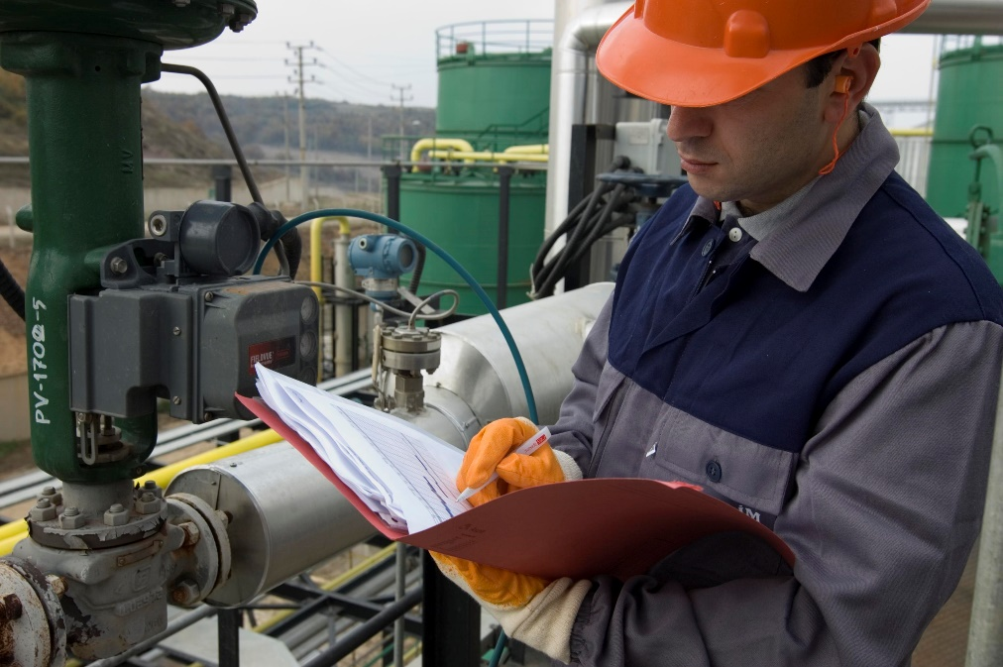
Engineering & Field Services
Instrument Calibration
Outages Services
Portable pressure calibrator (GE-Druck DPI-610)
Digital Test Gauge (GE-Druck DPI 104)
Hydraulic Hand Pump (GE-Druck PV212)
Pneumatic Pressure and Vacuum Pump (GE-Druck PV211)
Pressure calibration kit (Omega DPG4000)
Dry Block Temperature Calibrator (GE-Druck DBC 650TC)
Loop Calibrator (GE-Druck UPS-III)
Field Communicator Heart Emerson 375
Precision Multifunction Process Calibrator (Fluke 726)
MEMORY HiCORDER (Hioki 8847)
TEMPERATURE HiTESTER (Hioki 3442)
HIGH VOLTAGE INSULATION HiTESTER (Hioki 3455)
CLAMP ON AC/DC HiTESTER (Hioki 3290-10)
Radiation Type TEMPERATURE HiTESTER (Hioki 3415-01)
PHASE DETECTOR (Hioki 3129)
DC SIGNAL SOURCE (Hioki SS7012)
The Hand Held Tachometers (Ono Sokki HT-4200)
VIBROMETER WITH ANALYZER (Showa Sokki 1022A)
Sound Level Meter (RionNL-20)

Slide 11
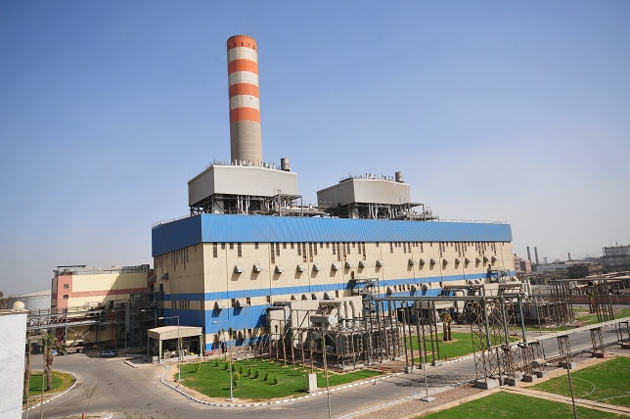
Commissioning
Power Plants
Outages Services
long experience in commissioning different types of power plants i.e. thermal power plants; simple cycle power and combined cycle power plants, our commissioning activities include commissioning of the following power plant main systems and equipment's services.
Gas and Steam turbine electromechanical systems commissioning.
Boiler or HRSG electromechanical systems commissioning.
Balance of Plant Preparation of commissioning procedures.
Water treatment systems commissioning.
Electrical and mechanical Equipment's inspection.
Electrical and mechanical equipment pre-commissioning and commissioning.
Interfacing, signaling, grounding, wiring continuity and loop check.
Protection relays testing and validation.
Field instrument calibration and loop check.
DCS, SCADA and PLC systems logic and functional testing and validation.
Hydro and pneumatic tests.
Piping flushing and blowout (air and steam).
Alignment of rotating machines (pumps, fans…etc).

Slide 12
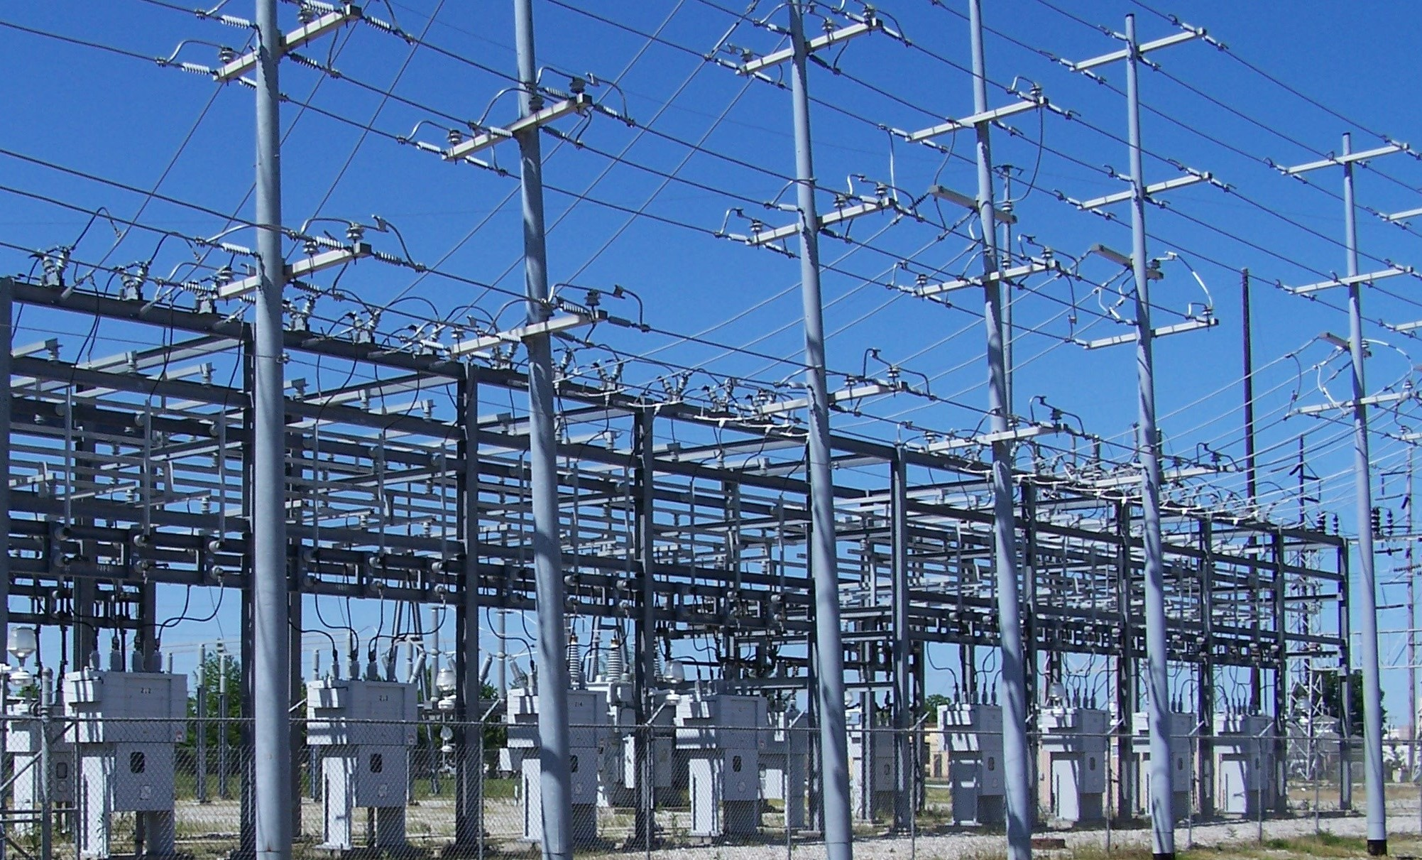
Commissioning
Substations
Outages Services
Wide experience in commissioning of all components up to 500KV (GIS) & outdoor (AIS) Substation; our commissioning activities include commissioning of the following substation main systems and equipments:
Circuit breaker testing (function, timing, contact resistance, contact travel distance).
Power transformer up to 500MVA and 500kV testing (insulation resistance, ratio, vector group, DC winding resistance, tan delta, frequency resonance analysis, oil testing…etc.)
Shunt reactors, capacitor banks & auxiliary transformers.
Current and potential transformers testing.
All components of up to 500KV (GIS) & outdoor (AIS) sub-station.
Cables continuity, insulation resistance and HV test as applicable.
AC dist. board, DC dist. board, neutral ground NGR. Resist. & ring main units RMU.
Relay & control panels, fault and sequence of event recorder.
Systems interfacing, stability, scheme, function and overall interlocking.
Relay & control panels factory testing, site training and factory training.
Grounding system testing.
Cables high voltage test up to 33KV.
Fire fighting and HVAC system.
DCS, PLC and SCADA systems.

Slide 13
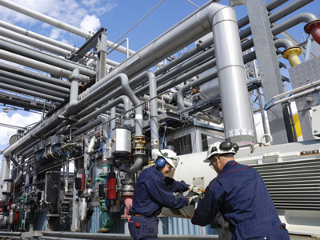
Operation & Maintenance
Power Plants
Outages Services
Provides operations & maintenance services during a power plant project lifecycle. We offer a wide range of O&M services, including complete turnkey operations models or through Manpower Staffing. We can also provide O&M services during first operation of power plant to tune the operating parameters to reach the highest possible efficiency.
Thermal Power Plant.
Simple Cycle Power Plant.
Combined Cycle power plant.

Slide 14











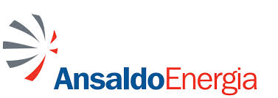

Expertise
Outages Services
Long-term contracts with key clients for operations & Maintenance ,projects management and support.
Value Proposition to clients is the ability to execute projects or mobilize support within quality, time and budget, and within the applicable regulatory framework.
Major Clients are:
GE (P&W and O&G across MENA Region) | Gas Natural Fenosa
KBR (Sadara, Jazan) | Toyota Tsusho and Toshiba
Saudi Aramco (Luberef, Satorp & SADARA) | NEM
Schlumberger | DOOSAN
Saudi Electricity Co. and Saudi Municipalities | HYOSUNG
Samsung C&T | Mitsubishi Electric
Ansaldo Energia and Ansaldo Caldaia | Alstom

Slide 15
Key Ongoing Projects
Client /Project | Country | Service | Details / Scope of Work
Jizan Gas Projects Co (JGPC ) | Saudi Arabia | PMC +ES | The world’s Largest Gas complex
RAWEC | Saudi Arabia | PMC + E&TS | Technical and Operational assistance (RAWEC 1) Recruitment, international mobility management and construction support (RAWEC 2)
RAWEC Power Co. RPC | Saudi Arabia | E&TS | long term contract- Engineering, O&M and technical service
LUBREF / ARAMCO | Saudi Arabia | PMC + E&TS | Engineering , O&M Support Services (LUBREF 1 & LUBEREF 2)
King Faisal University – Housing complex project 280,000 m2 | Saudi Arabia | PMC | Complete project management and supervision
GE O&G - Artificial lift - Khurais Oil field | Saudi Arabia | E&TS | long term contract – ESP Field commissioning
GE O&G - M&C / NGL Yanbu | Saudi Arabia | E&TS | Instrumentation and control field engineering services
GE O&G - M&C | Saudi Arabia | FS | I&C Field services
GE - P&W -5th largest worldwide GE R&D center | Saudi Arabia | MP | Staffing Technical consultation
M+W / Boston Collage | Saudi Arabia | E&TS | MEP & HVAC – Technical engineering services
M+W/ Pharmaceutical Factory | Saudi Arabia | MP | Staffing engineering and technical team
JGC / Petro Rabigh phase 2 | Saudi Arabia | E&TS | Staffing engineering and technical team
Alkhalle Project – Schlumberger | Saudi Arabia | E&FS | Oil Well exploration with High H2s content, HPHT Wells
Sadara Chemicals | Saudi Arabia | PMC | Commissioning and Loop Checks
Kuraimat PP – GE P&W | Egypt | E&TS | Full outage scope
Assuit Power Station GE P&W | Egypt | E&TS | Installation, testing & commissioning 8X Frame 9E
Damietta Power Station GE P&W | Egypt | E&TS | Installation, testing & commissioning 4X Frame 9E
Various Mobile station (20x25MW) GE P&W | Egypt | FS | Power Plant Operation
Various TM PP - GE P&W | Egypt | E&TS | Commissioning & Operation of 10X 25M GT
Al Zubair Project GE O&G TM | Iraq | FS | Field engineering services
West Qurna GE O&G TM | Iraq | FS | Field engineering services
GE P&W - PGP | Iraq | FS | Power plant outage & Technical services
GE O&G Jafaza | UAE | E&TS | Long-term back office Engineering support
GE Algeria | Algeria | MP | Back office support and technical services

Slide 16
Key Completed Projects
Client /Project | Country | Service | Details / Scope of Work
SATORP – Aramco / Total JV | Saudi Arabia | E&TS | Technical engineering service
Saudi Electricity Co. (SEC) | Saudi Arabia | PMC | 5 year general engineering service and technical support
Shedgum to Riyadh 380kV T/L. and Faras to Al-Kharj 380kV T/L, and +280/-0 MVAR SVC installation at Wasia S/S | Saudi Arabia | E&TS | 21 POWER, TRANSMISSION & DISTRIBUTION PROJECT
Quorayyah IPP (6x750MW) Samsung C&T | Saudi Arabia | FS | BoP Commissioning and Operation, GT TA support
Sidi Krir CCPP (1x750MW) Toshiba – Toyota Tsusho | Egypt | FS | BoP Commissioning and Operation, Warranty Rep.
Sidi Krir CCPP (1x750MW) NEM | Egypt | FS | HRSG Commissioning and Operation
Al Atf CCPP (1x750MW) Toshiba – Toyota Tsusho | Egypt | FS | BoP Commissioning and Operation, Warranty Rep.
Al Atf CCPP (1x750MW) NEM | Egypt | FS | HRSG Commissioning and Operation
Damietta 220kV GIS Substation Hyosung Corporation | Egypt | E&FS | Relays setting Calculations and Construction supervision
Aswan High Dam DCSUpgrade Alstom | Egypt | FS | Commissioning and start- up of new DCS system.
6th October SCPP (4x150MW) Ansaldo Energia | Egypt | FS | BoP Commissioning and Operation, GT TA support
AbuQir Thermal PP (2x650MW) Ansaldo Caldaia | Egypt | SF | Boilers Commissioning and Operation

Slide 17
Key Completed Projects
Client /Project | Country | Service | Details / Scope of Work
Bahteem and El Mashtal 220/66 KV Areva T&D | Egypt | FS | Testing & Commissioning of Substation & TL Remote End Port Sys.
Al Khairat Power Station GE P&W | Iraq | E&TS | one year complete O&M Program
Sulaymania SCPP (2x125MW) ABB Mannheim | Iraq | FS | BoP Commissioning and Operation, GT TA support
Erbil SCPP (2x125MW) ABB Mannheim | Iraq | FS | BoP Commissioning and Operation, GT TA support
Dohuk SCPP (4x125MW) ABB Mannheim | Iraq | FS | BoP Commissioning and Operation, GT TA support
Qatalum and Abu Fontas PP ABB Mannheim | Qatar | FS | Electrical Installation, Commissioning and Project Controls Support.
Benghazi 319 pumping station ABB Mannheim | Libya | FS | Electrical Installation, Commissioning and Project Controls Support.
Deir Ali II CCPP (1x750MW) Gas Natural Fenosa | Syria | E&FS | Design Review and Construction Supervision

